Slide 1
Riya 1.0 The Personal Assistant

Slide 2
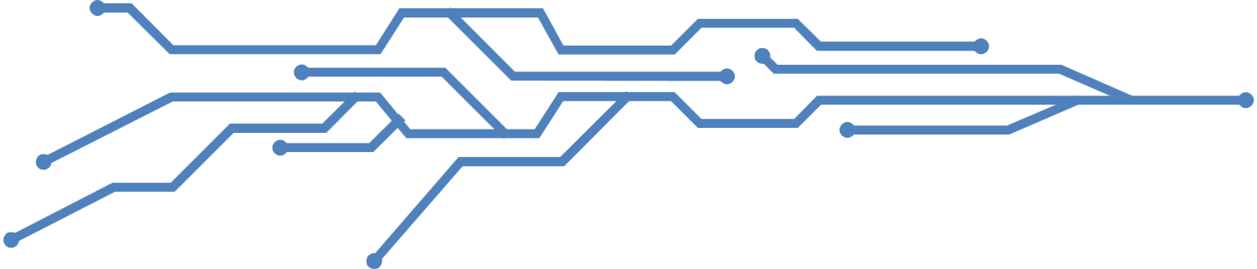
A virtual assistant, also called AI assistant or digital assistant, is an application program that understands natural language voice commands and completes tasks for the user.
Such tasks, historically performed by a personal assistant or secretary, include taking dictation, reading text or email messages aloud, looking up phone numbers, scheduling, placing phone calls and reminding the end user about appointments. Popular virtual assistants currently include Amazon Alexa, Apple's Siri, Google Assistant and Microsoft's Cortana.

Slide 3
Modules
pyttsx3
pyaudio
Wikipedia
speech_recognition

Slide 4
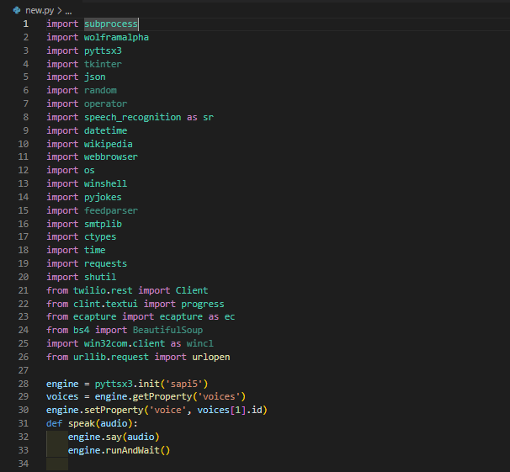
Source code

Slide 5
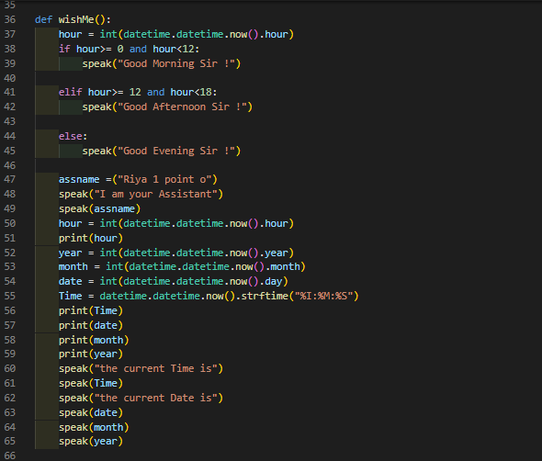
Source code

Slide 6
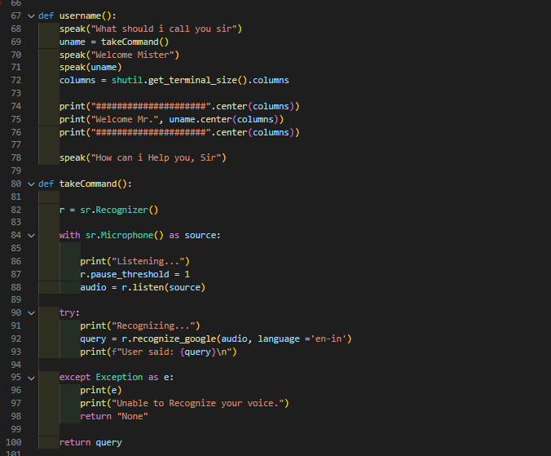
Source code

Slide 7
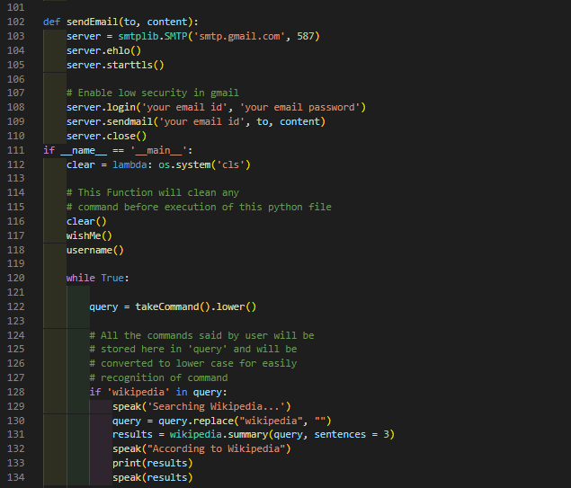
Source code

Slide 8
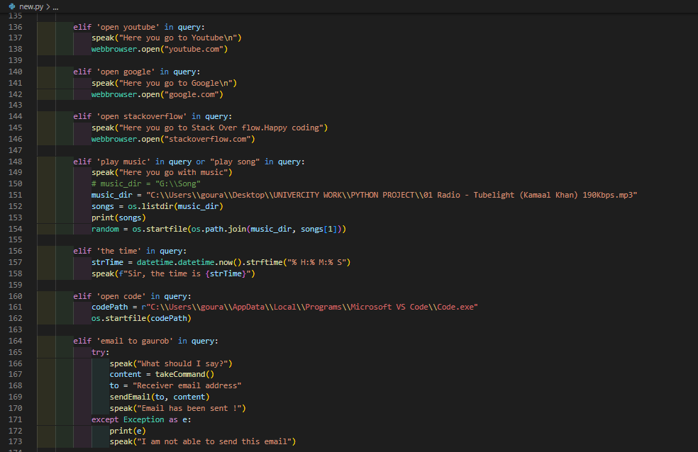
Source code

Slide 9
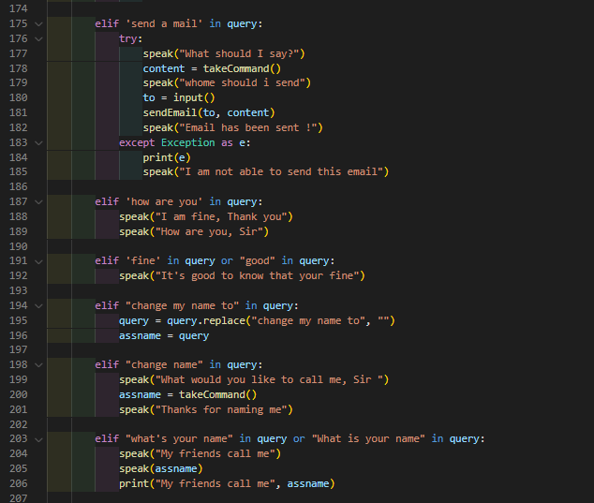
Source code

Slide 10
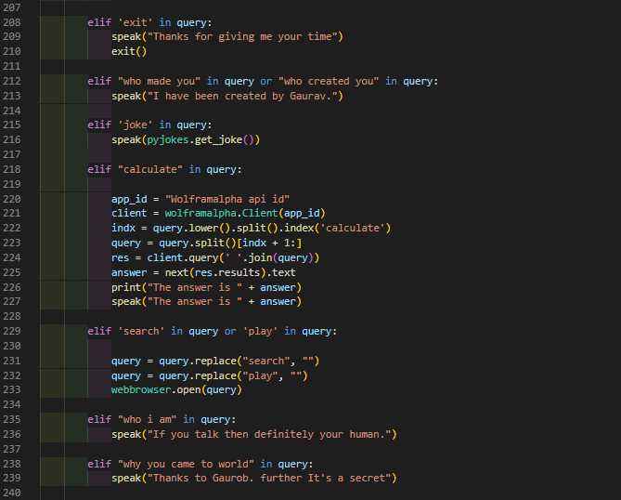
Source code

Slide 11
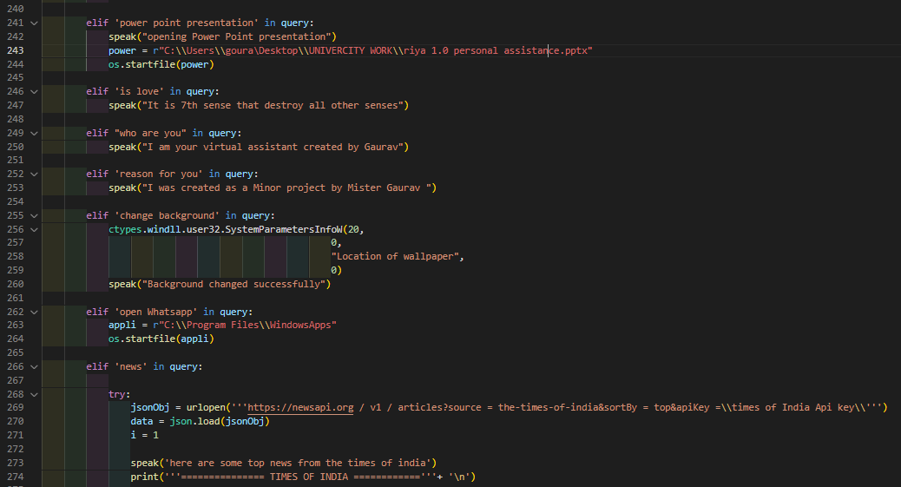
Source code

Slide 12
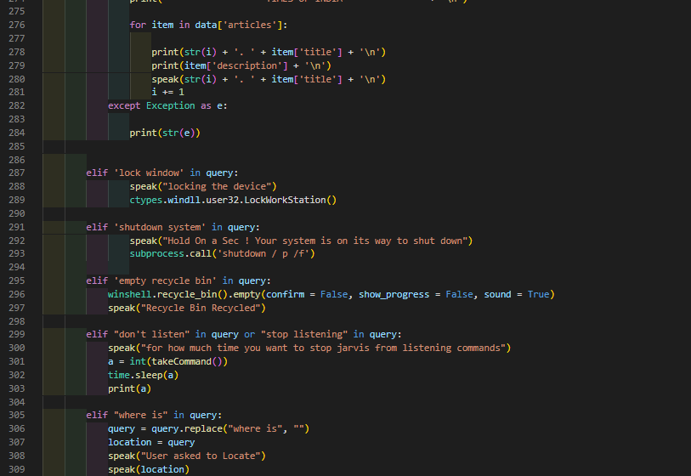
Source code

Slide 13
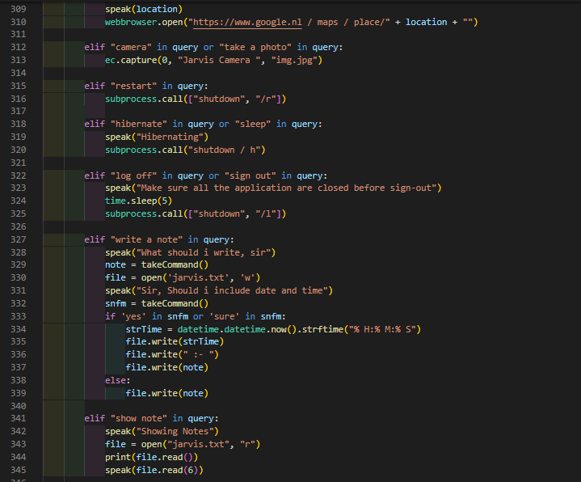
Source code

Slide 14
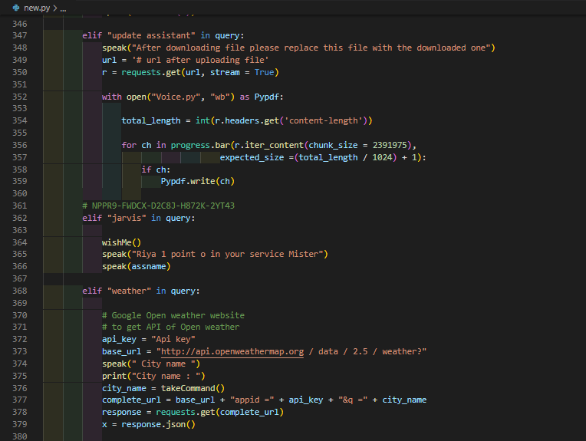
Source code

Slide 15
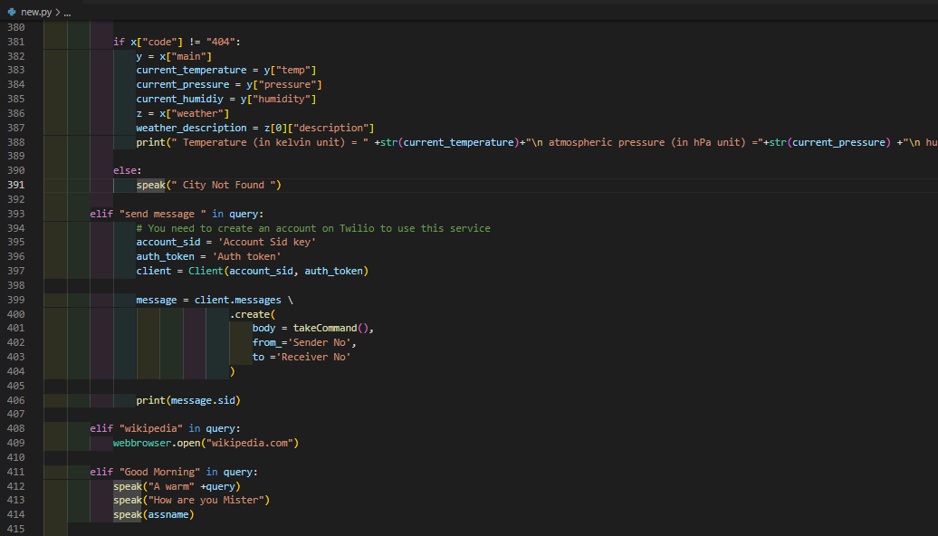
Source code

Slide 16
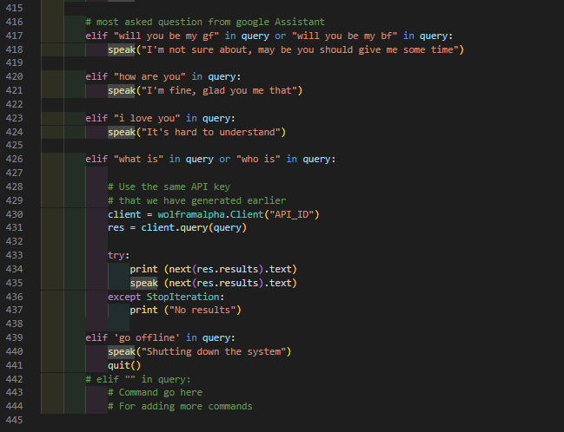
Source code

Slide 17
Thank You
By Gourob das
Ref no- 22352218
MCA -1st semester

